Slide 1

Data Analysis on Bank Customers
By Subhadwip Manna
Under guidance of Dr. Aakansha Gupta

Slide 2



Introduction
The goal of this analysis is to explore a dataset containing information on bank customers and their payment behavior, and to use data visualization techniques in Tableau to gain insights into the factors that contribute to attrition from bank.
In this analysis , we will use Python libraries such as Pandas to explore the dataset, perform data cleaning and preprocessing, and create visualizations by using tableau to analyze the data.

Slide 3
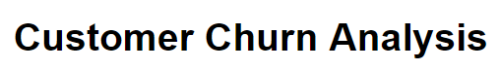
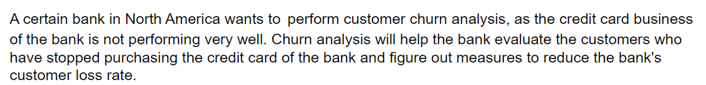



Slide 4

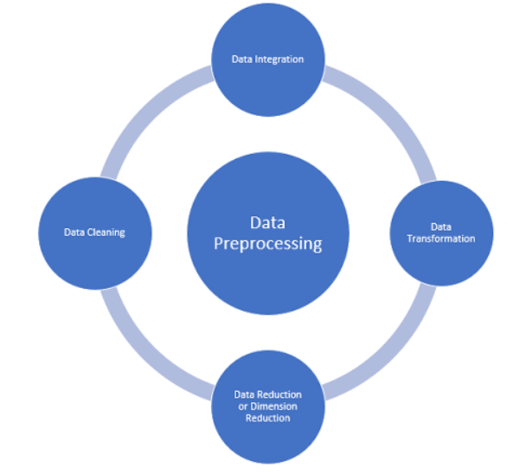
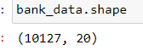
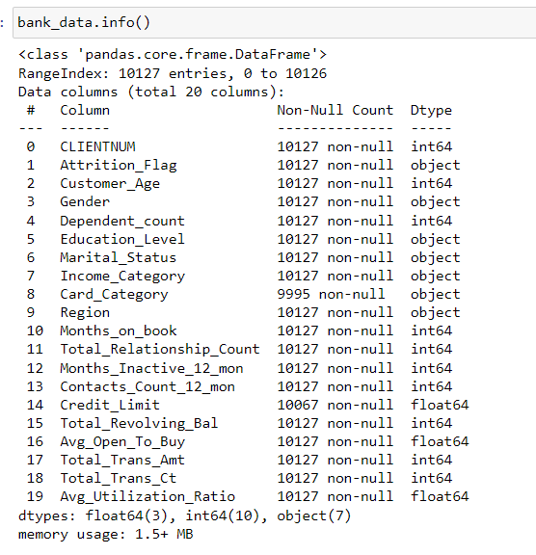
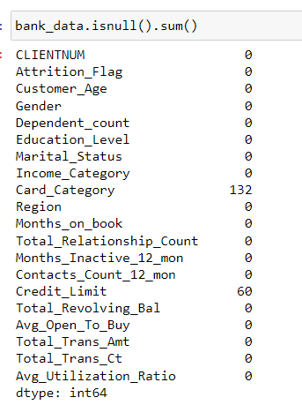
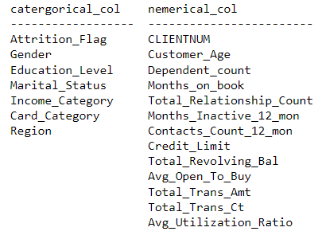

Slide 5

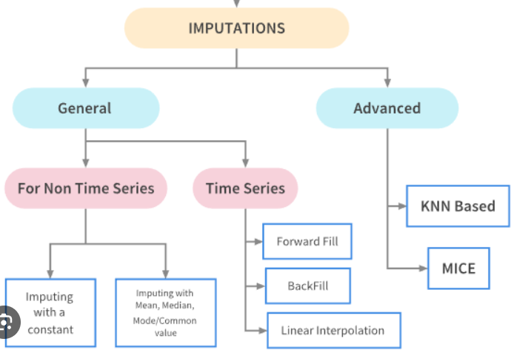
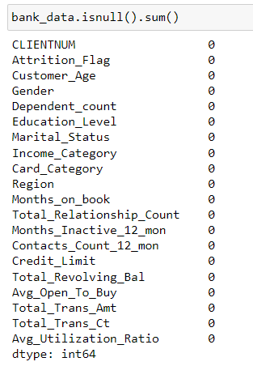
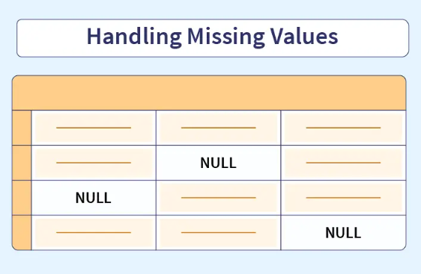

Slide 6
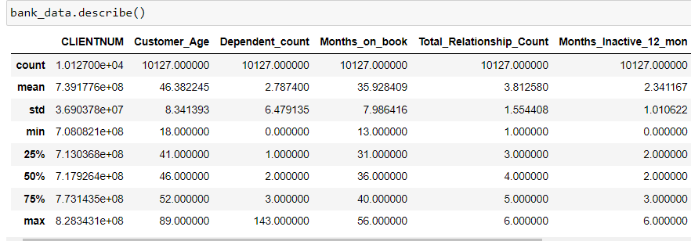
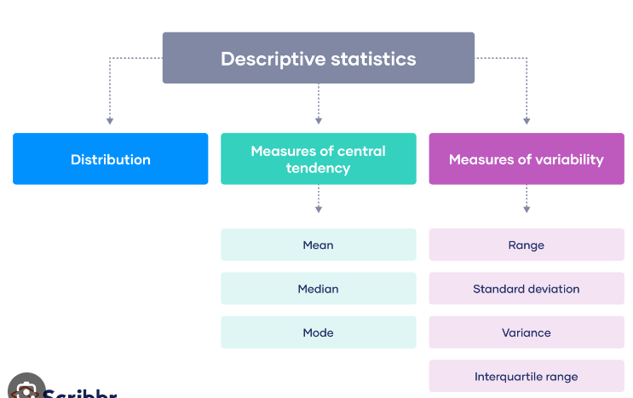
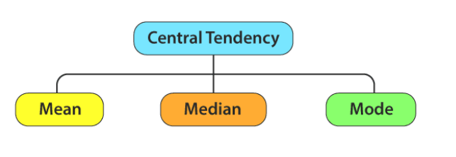
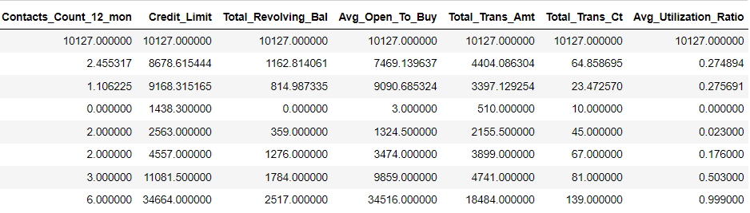
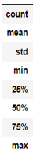
50% of the customers age is in between 41 to 52.
Maximum dependent count is 143,which is not valid
As per data last person purchased loan more than 1 year ago.
Credit limit, avg open to buy , total trans amt has high standard deviation so data of these features are widely distributed and high skewed.
there maximum values are too high from 75% quantile ,
may be they have outliers, we need to check.

Slide 7


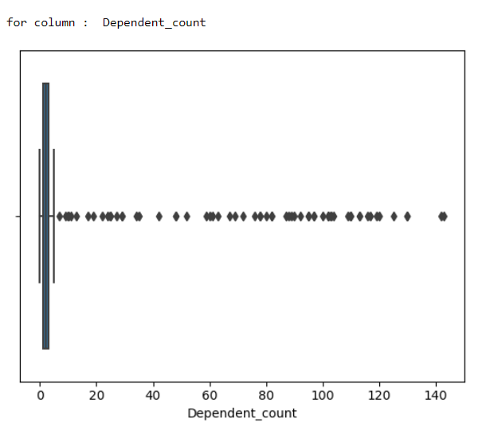
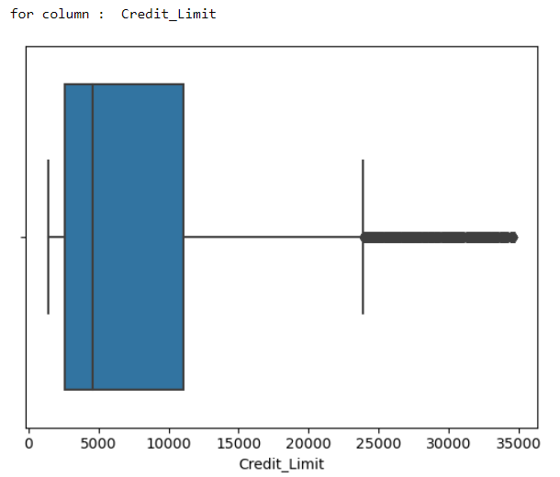
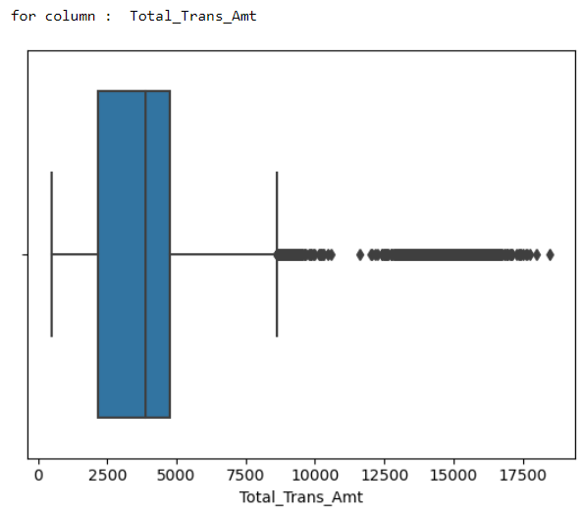
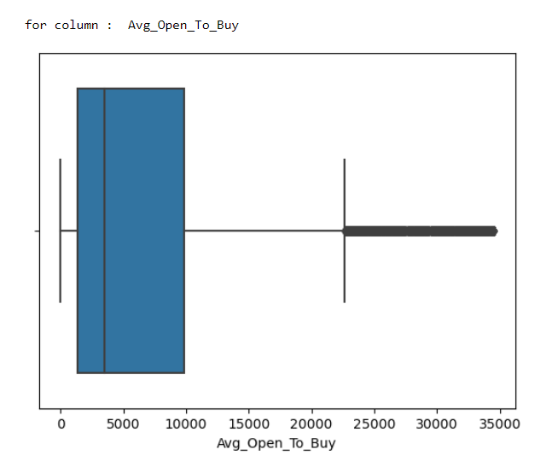

Slide 8

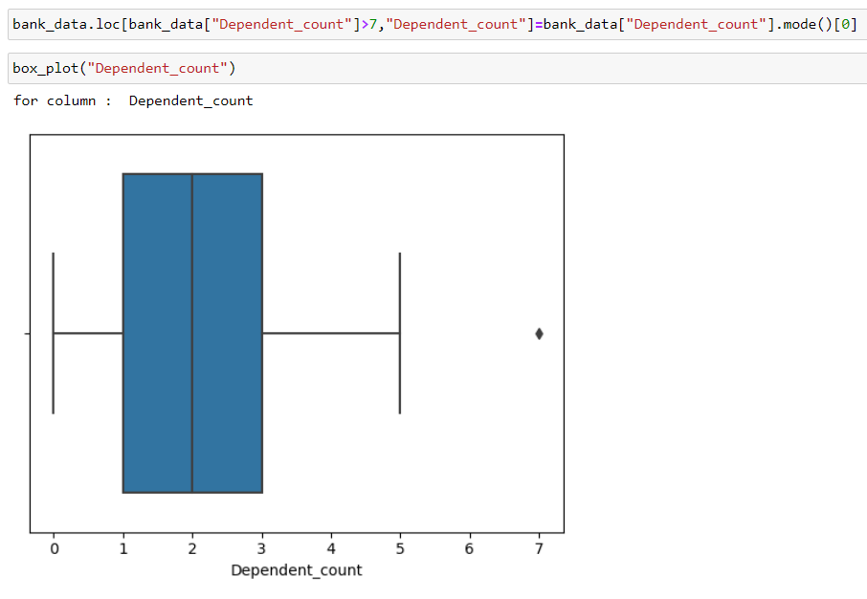
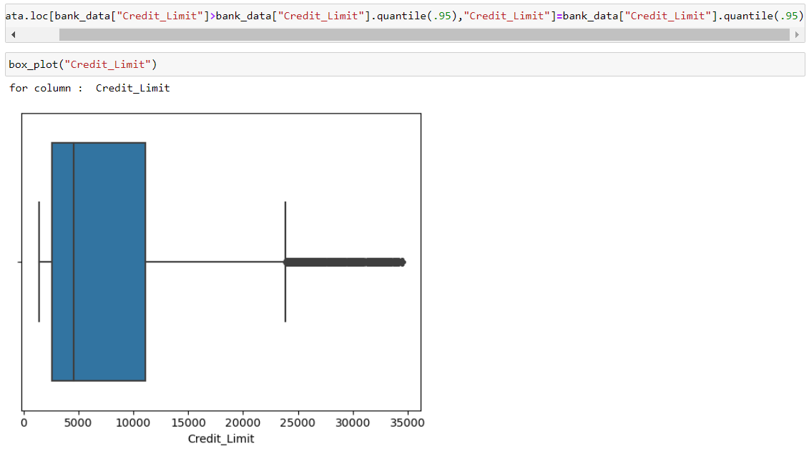

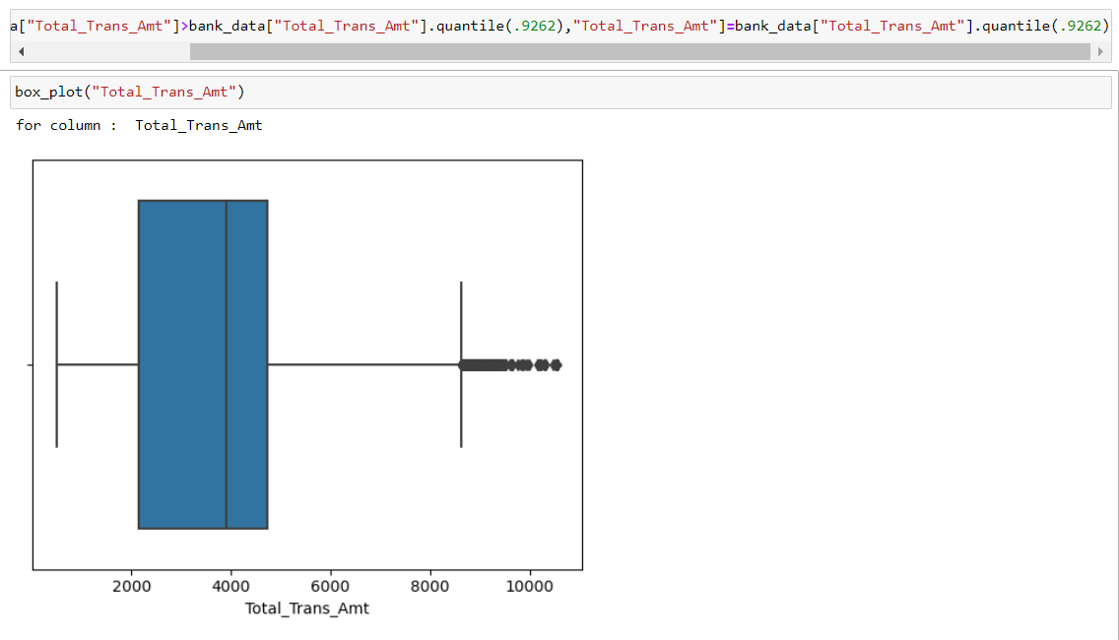
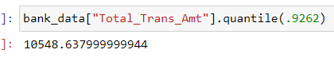
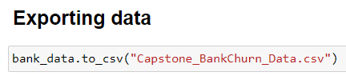

Slide 9
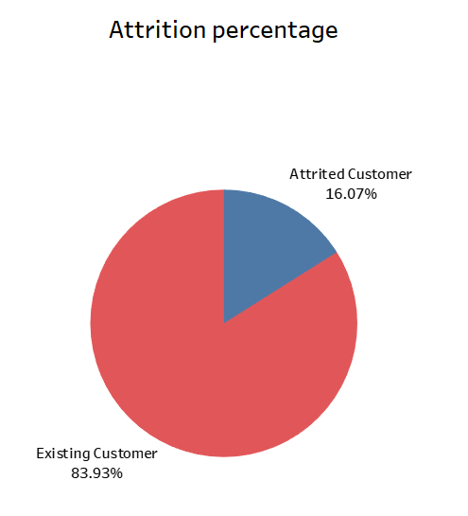
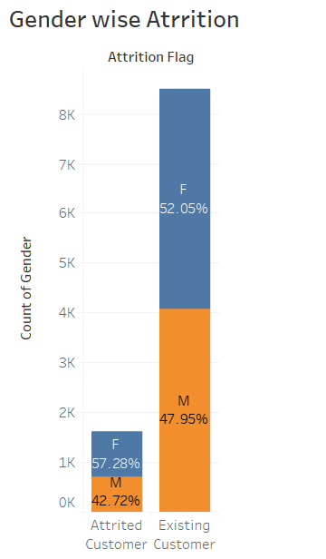

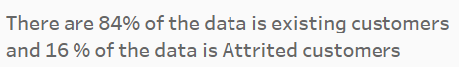

Slide 10
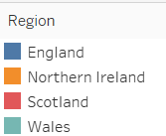
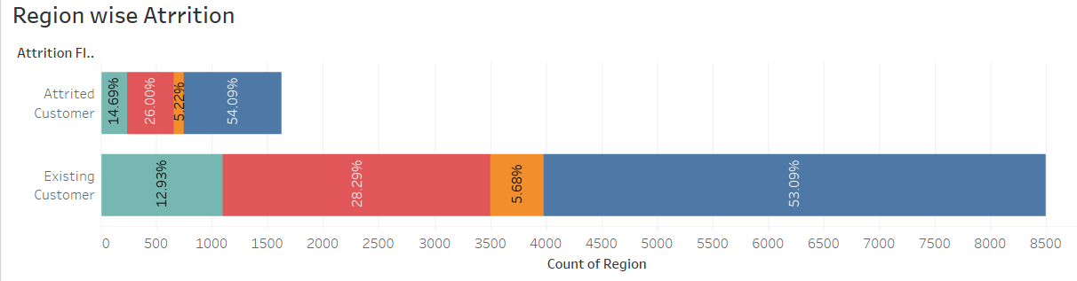
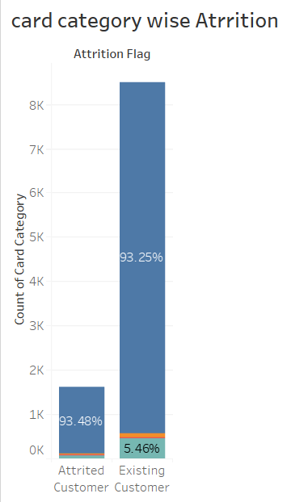
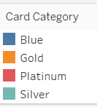



Slide 11
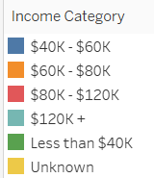
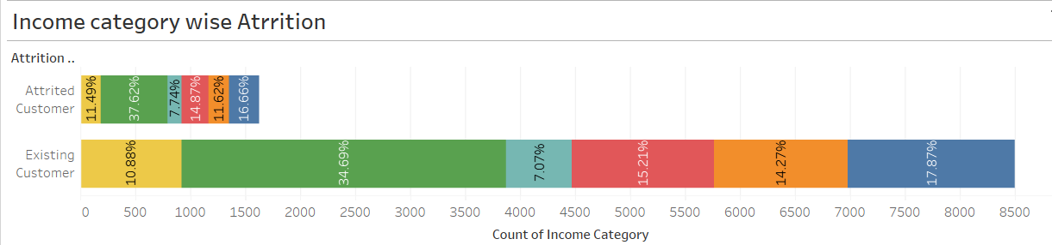

Customers who earns less than $ 40 K have higher attrition rate
Who earns $ 60 K to $ 80 K have less chances of attrition
Attrition is high for lower income

Slide 12
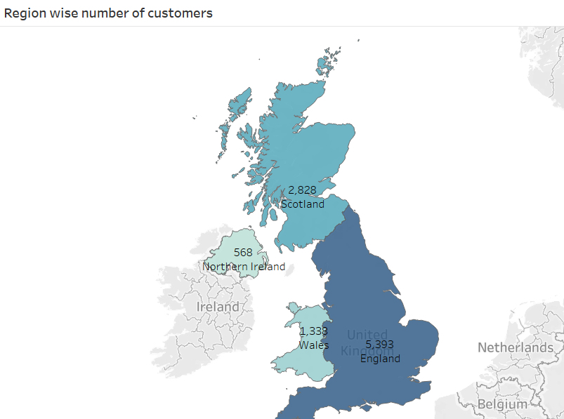



Slide 13
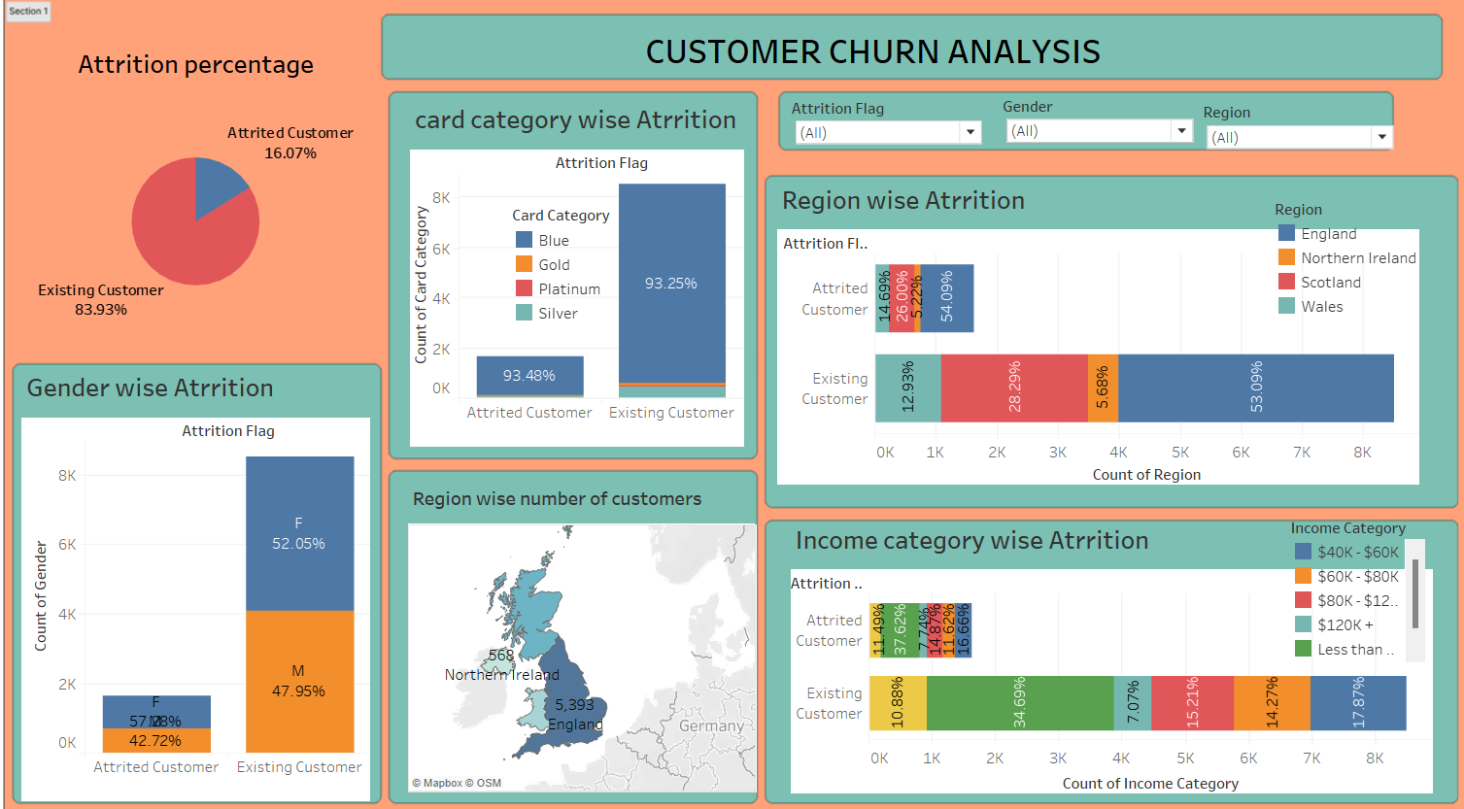

Slide 14
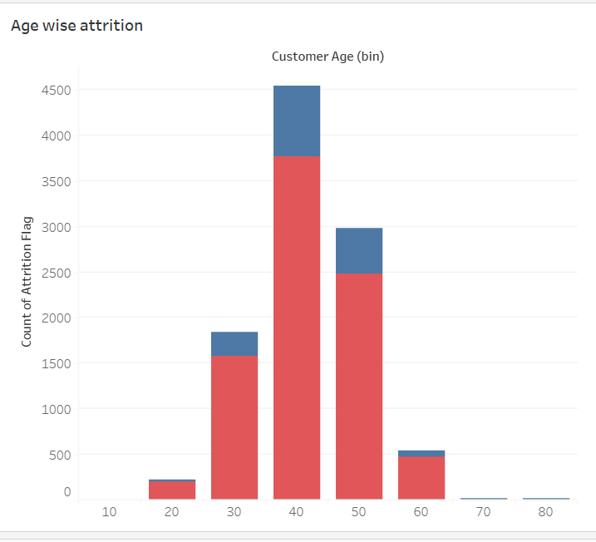

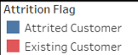
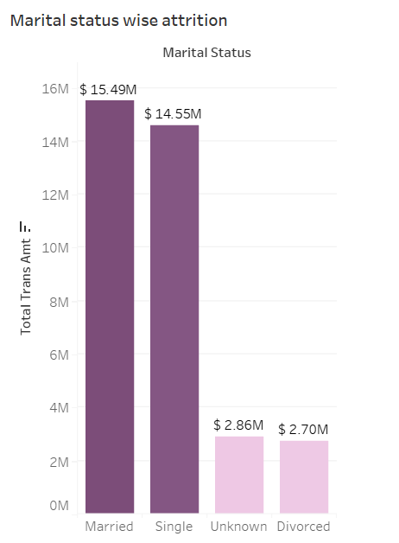

Single
Married

Slide 15
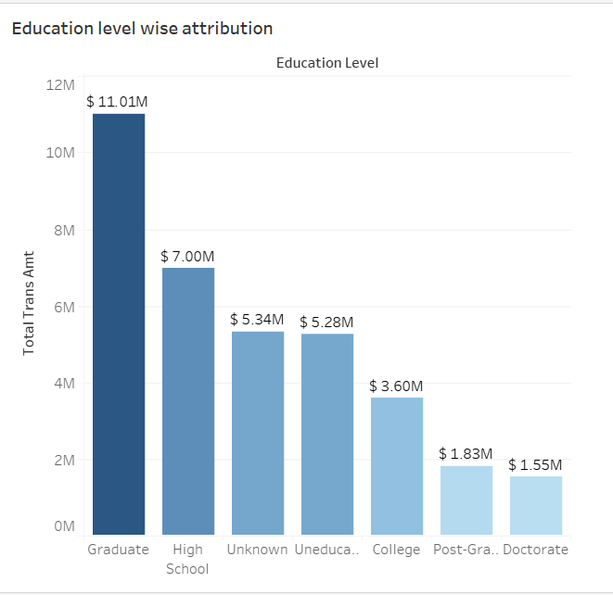
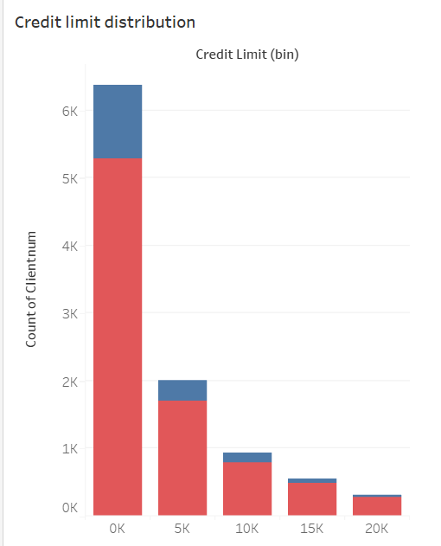


Slide 16
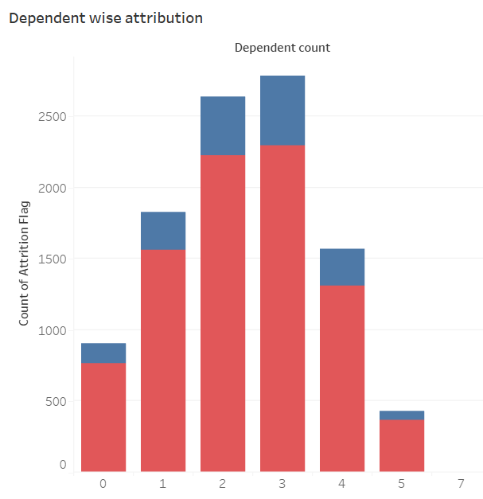
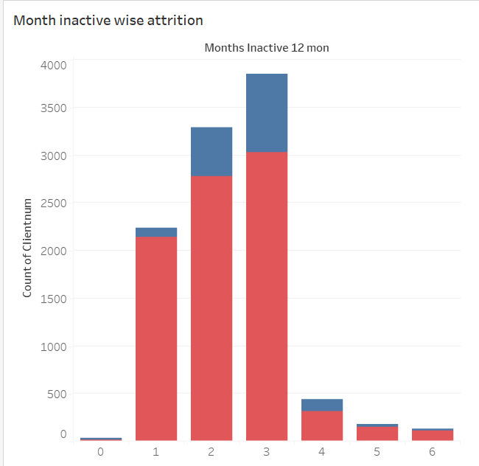

Slide 17
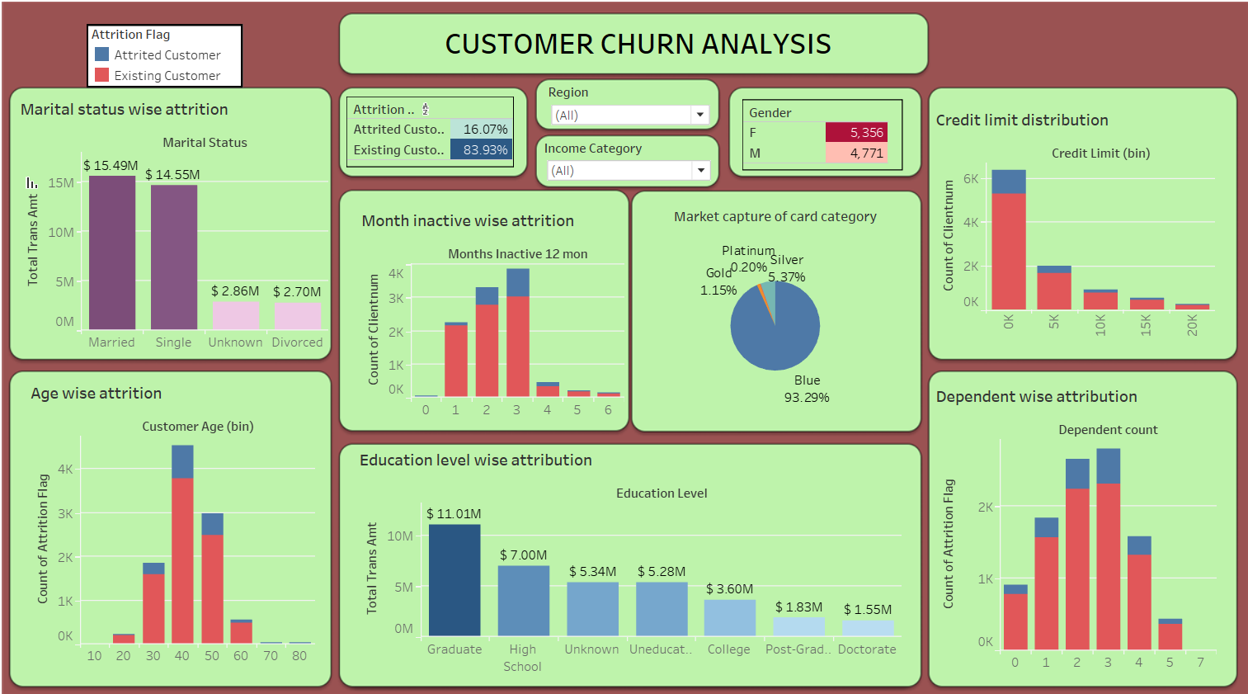

Slide 18
Summary
Only 16% customers are attrited from the bank as per the dataset.
Chances of females for attrition is higher than males.
Attrition is high for lower income
Customers form England uses the credit card more than other region
90% of customers preferred blue credit cards.
Customers with less dependencies have less chances of attrition.
Customers who are already inactive for 3 months have high chances of attrition whether if the person is inactive for 1 month then no need to worry because there is less chances of attrition..

Slide 19




Thank you

